Slide 1
Cloud based online buss pass system
Prepared By :
2000031608 – sai kumar

Slide 2
We propose to build a unique and easy to use local train ticketing project for efficient robust ticketing system using cloud infrastructure. The system allows users to register and as soon as they register an account with unique id is created in the system. User may book tickets for western, central and harbor lines and fare is calculated according to station distance. The cloud server allows for handling a large number of users using efficient computing power. It allows for efficient and fast computing for ticket costs to numerous users at a time. This balance is later deducted from user’s account. User may later recharge his account through admin. • Admin account: Admin has a login from where he can manage users account and can even recharge their account on users demand. • Member login/register: New users may register and login to the system. • Unique Id creation: Each time a new user registers, a unique id is generated for that user. • Member account maintenance: Each members account and their respective balance are maintained in the system. • Account balance updating: The account balance is updated each time the user wishes to recharge his account through an admin. • Ticketing facility: The user can take single or return ticket and the ticket cost is calculated depending upon the distance between source and destination stations.

Slide 3
Customer can buy the bus ticket over the Internet, 24 hours a day throughout the week, this solves the issue of bus ticket being misplaced or stolen. Users can recharge through cc or debit car. The site may get overloaded due to huge number of users visiting at once. Thus this system is built up using cloud infrastructure for improved performance. In addition, the online system lets the customers check the availability of the bus ticket before they buy bus ticket. Furthermore, customers no need to pay cash to buy bus ticket because they can pay the bus ticket by using Credit Card (e.g. Master Card, Visa Card). Hence, there is a need of reformation of the system with more advantages and flexibility. The Bus Scheduling and Booking System eliminate most of the limitations of the existing software. Bus pass web system to put it simply, means system can provide pass identification using BAR code, Pass renewal, cancellation, updating, Student discount etc. • Using this website we can check all details related Bus pass and instruction like how to renew pass how to update it, and also provide details of student discount. • This website keeps all information of all Bus passes. • Passengers first need to verify themselves the system using various through registration. Once verified the system allows them to book passes for any route online. • Users can recharge through cc debit cards.

Slide 4
Technology Used in the project Bus Ticket Booking System
We have developed this project using the below technology
-> AWS Lambda Function: All of the businesss login we have developed in Lambda Function
-> Dynamo DB: We have used Dynamo DB Database for storing all the data.
-> API Gateway: All of the API operations we are handling with API Gateway
-> S3 Bucket We have uploaded UI codes of Bus Ticket Booking System on S3 Bucket
-> Cloud Formation All deployment of Bus Ticket Booking System, we are doing with AWS Cloud Formation
-> Serverless Framework: We have used Serverless Framework for developing this application
-> Angular: All of the UI components of Bus Ticket Booking System, we have developed in Angular

Slide 5
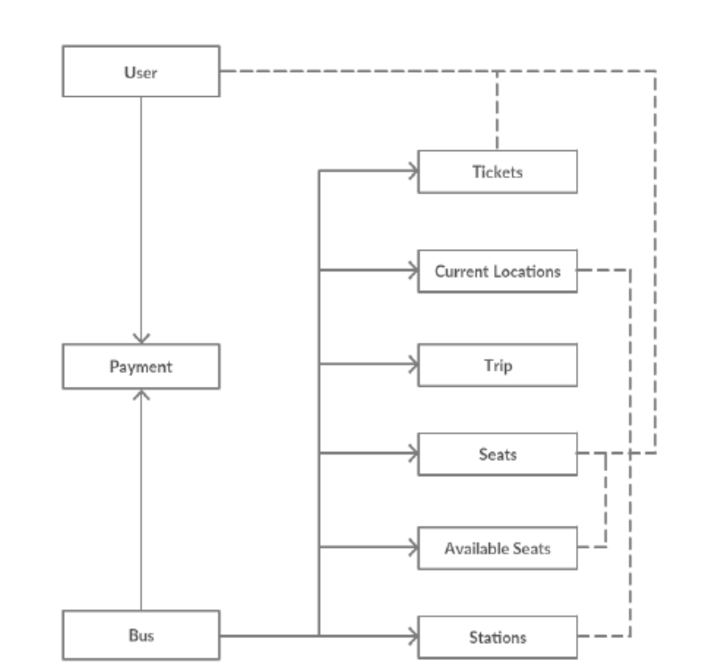

Slide 6
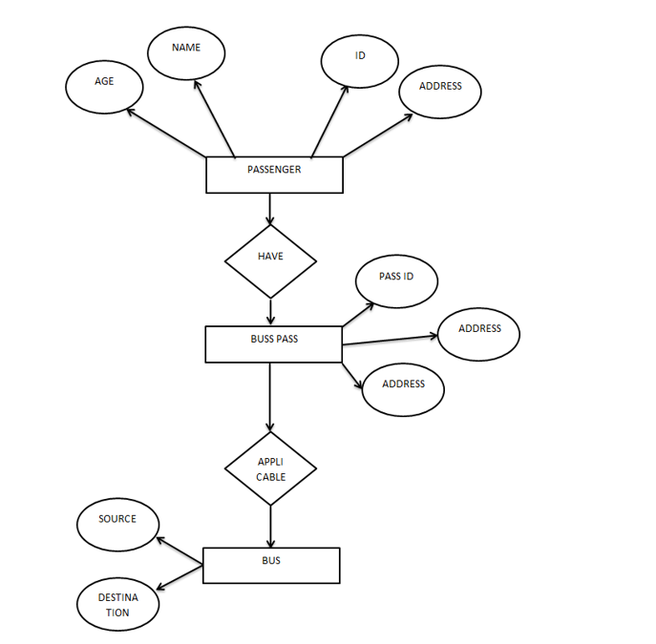
ER Diagram

Slide 7
ADVANTAGES
Passengers don’t have to waiting time in queue.
Its mostly used for most of the employers.
Information is accurate.
It is a fast process

Slide 8
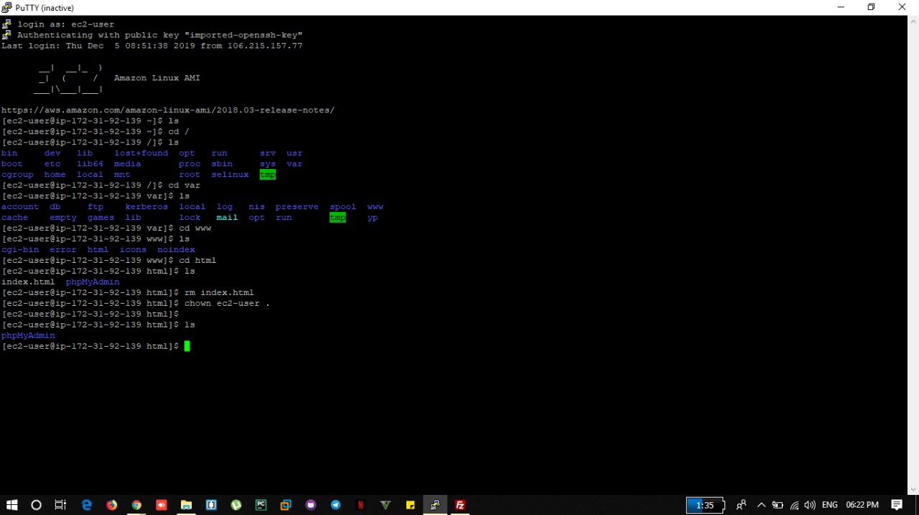
Command on putty

Slide 9
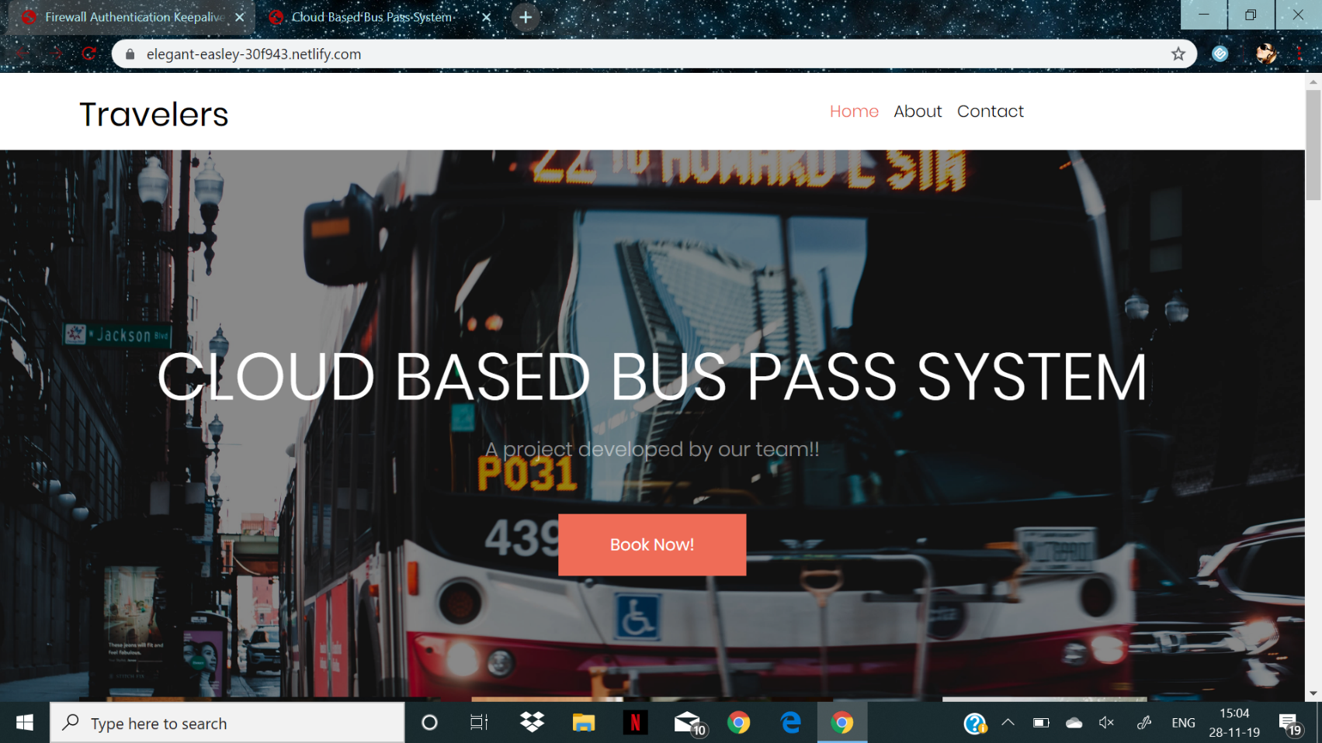
GLIMPSE OF PROJECT

Slide 10
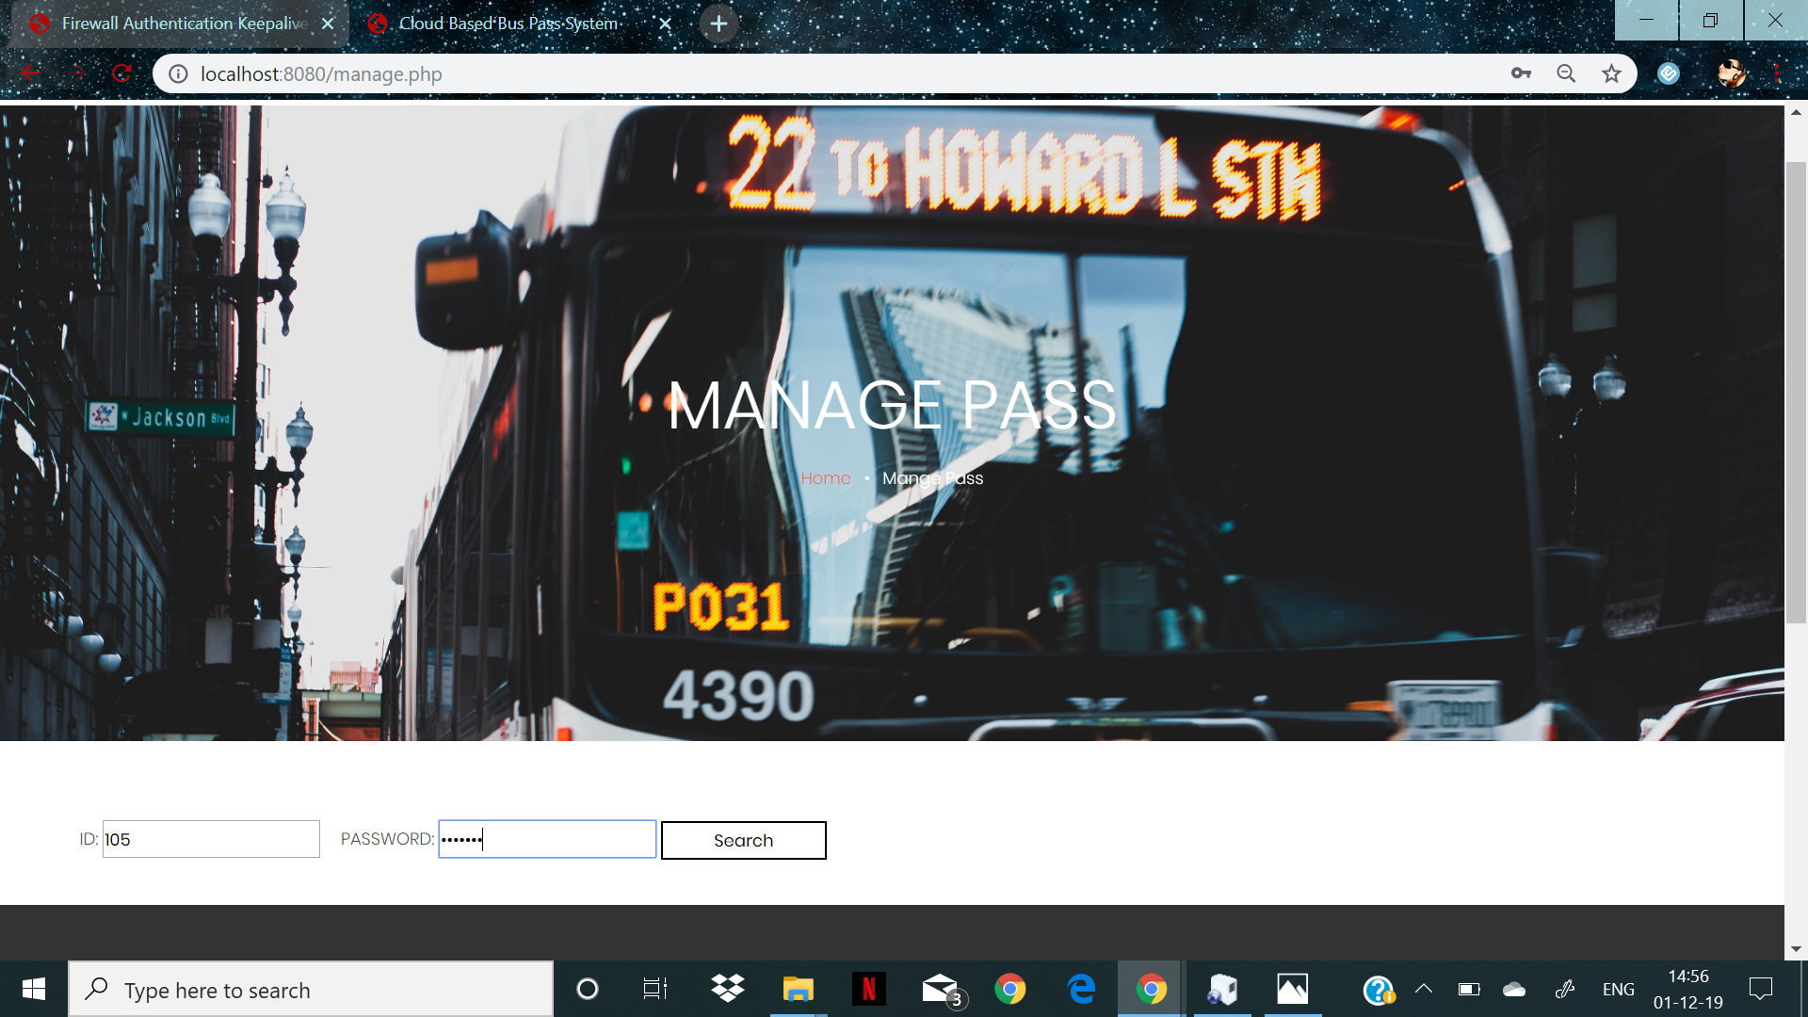
Managing the pass

Slide 11
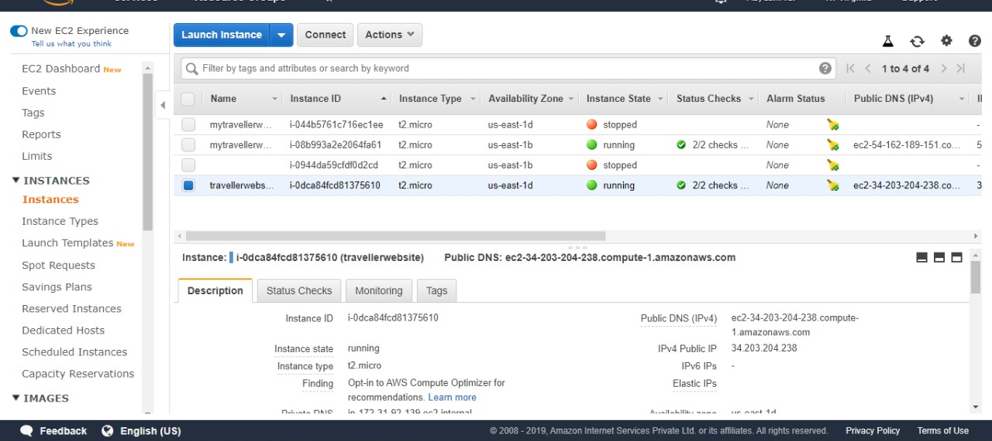
Creating instances on aWS

Slide 12
CONCLUSION
Bus pass Registration and Renewal System Project is a real time project which is useful for the people who are facing problems with the current manual work of bus pass Registration and renewal. It also increases the validity period, frequently Warns to the student before completion of his validity period by website. His / Her Renewal or Registration can be done using a voucher or even by a credit card.
This online bus pass registration application will help students save their time and renewal bus passes without standing in a line for hours near counters. Initially people need to register with the application by submitting details of photo, address proof, and required details and submit through online. They will verify your details and if they are satisfied they will approve bus pass. You can even renewal using credit card or other wire transfer methods.

Slide 13

Thank you

